Slide 1


WIRELESS CHARGING STATION FOR ELECTRIC VEHICLES BASED ON IOT
AY 2020-24
GITAM UNIVERSITY
Major Project
Project ID: XX
A University should be a place of light, of liberty, and of learning.
Department of Electrical Electronics and Communication Engineering
Project Team:
NISCHITHA J
SHAIK MAHAMMAD SHAFI
BASAVA RAJ G NAGANAGOUDER
Project Mentor:
DR.ROHAN PRASAD
www.gitamedu.com

Slide 2




Project Group – Details
Photo
Track
Roll No
Name
Photo
EEE
BU21EECE0200036
NISCHITHA J
Photo
EEE
BU21EECE0200044
SHAIK MAHAMMAD SHAFI
Photo
EEE
BU21EECE0200060
BASAVA RAJ G NAGANAGOUDER

Slide 3
Objective and Goals
Objective
To develop a wireless power transmission system to charge the battery.
To optimize coil power consumption when no vehicle is there.
To reduce the size of the battery used in the vehicle.
To develop a Robotic car to show continuous power delivery to the battery.
Goals
Main Goals
To Reduce battery size and cost
To improve EV uptake
To improve operational efficiency
To Extend driving range.
Additional Goals
To Reduce pressure on the electric grid
To Enable the electrification of autonomous vehicle.

Slide 4
Project Plan
Jan
JUL
Feb
AUG
SEP
OCT
May
June
DEC
July
Aug
Sep
Oct
Nov
Dec
NOV
TEAM FORMATION
GUIDE SELECTION
PROBLEM DEFINE
LITRATURE SUREY
METHODOLOGY
Specification
Integration
Initial testing
Finishing
Current progress

Slide 5
Literature Survey
Key Publications
An IoT-Based Wireless Charging Service for the Public
A review on iot based electric vehicle charging and parking system
IoT Grid Alignment Assistant System for Dynamic Wireless Charging of Electric Vehicles
Key Resources
Google scholar

Slide 6
Ref No.​ | Title of paper​ | Abstract​ | Outcome​
1. | An IoT- based wireless charging service for the public | As mobile phones become integral to daily life, the demand for public charging services has risen. To address issues such as locating chargers, monitoring their status, and managing costs, they developed AnyCharge, an IoT-based wireless charging system. Featuring Wi-Fi enabled chargers, an IoT gateway, a cloud management platform, and a mobile app, AnyCharge allows users to easily find and navigate to available chargers. | A large-scale deployment in Taiwan, Thailand, Singapore, and Japan, with over 200 chargers installed, confirms strong demand for this service
2. | ​ IoT grid alingment assistant system for dynamic wireless charging of electric vehicles | This paper addresses the challenges of electric vehicle (EV) adoption, such as high costs and limited charging infrastructure, by proposing smart parking solutions that include EV charging stations in commercial buildings. This integration aims to simplify parking and reduce time spent locating and using charging stations | This integration aims to simplify parking and reduce time spent locating and using charging stations

Slide 7
Ref No.​ | Title of paper​ | Abstract​ | Outcome​
3. | A review on IoT- based electric vehicle charging and parking system | The Grid Alignment Assistant System (GAAS) is proposed to enhance wireless vehicular charging by helping drivers align their vehicles with road-based charging grids. GAAS exploits low cost and open hardware and software components. | This paper presents road test results showing that high precision misalignment estimations can be achieved, and presents some challenges imposed by the actual deployment environment.

Slide 8
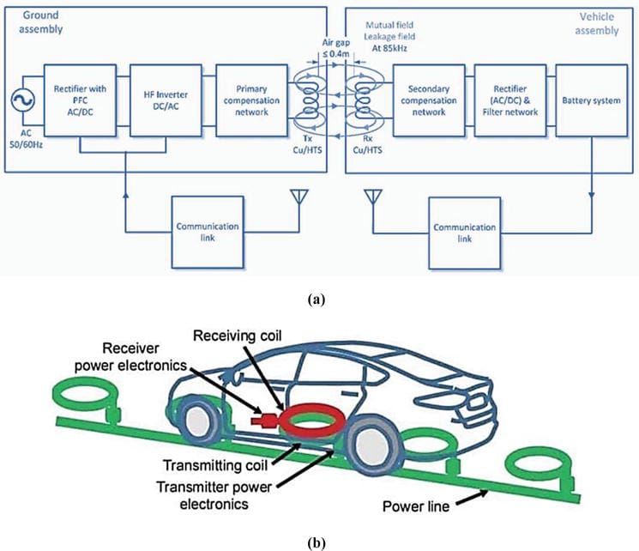
Architecture
Structural Diagram

Slide 9
Analysis - SWOT
Strengths
Weaknesses
W1. Higher cost
W2. Installation and space requirement
W3. Compatibility Issues
S1. Convenience
S2. Reduced Cable clutter
S3. User-Friendly
S4. Innovative Technology.
Threats
T1. Power loss and Inefficiency
T2. Economic Factor
Opportunities
O1. Expansion into new markets
02. Innovative Product designs
O3. Advancement in New Technology
04. Enhanced Consumer Convenience
05. Integration with new Devices

Slide 10
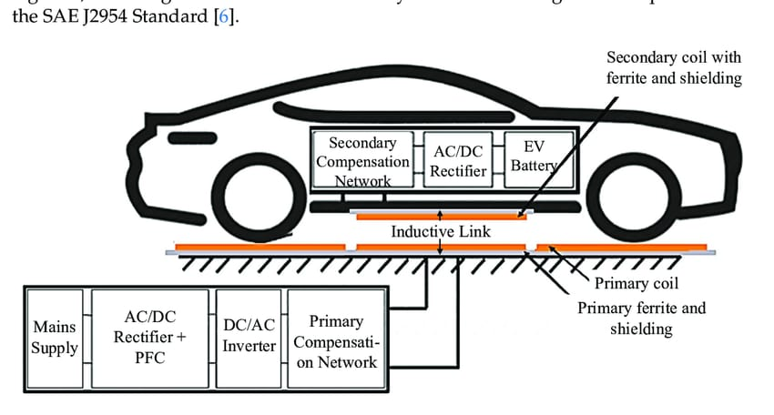
Model:

Slide 11
Analysis – 4W1H
Why:Wireless charging for electric vehicles simplifies the charging process by eliminating the need for physical connectors, allowing for automatic and more convenient charging.
What: a method of transferring energy between a power source and a device without physical connectors,
Where: Wireless charging pads installed in parking spaces or garages can charge electric vehicles without plugging in cables
When: On-going process

Slide 12
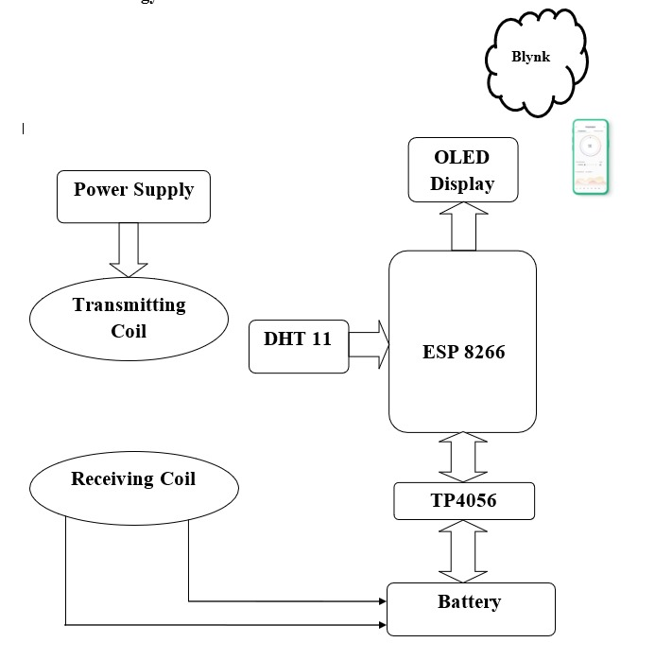
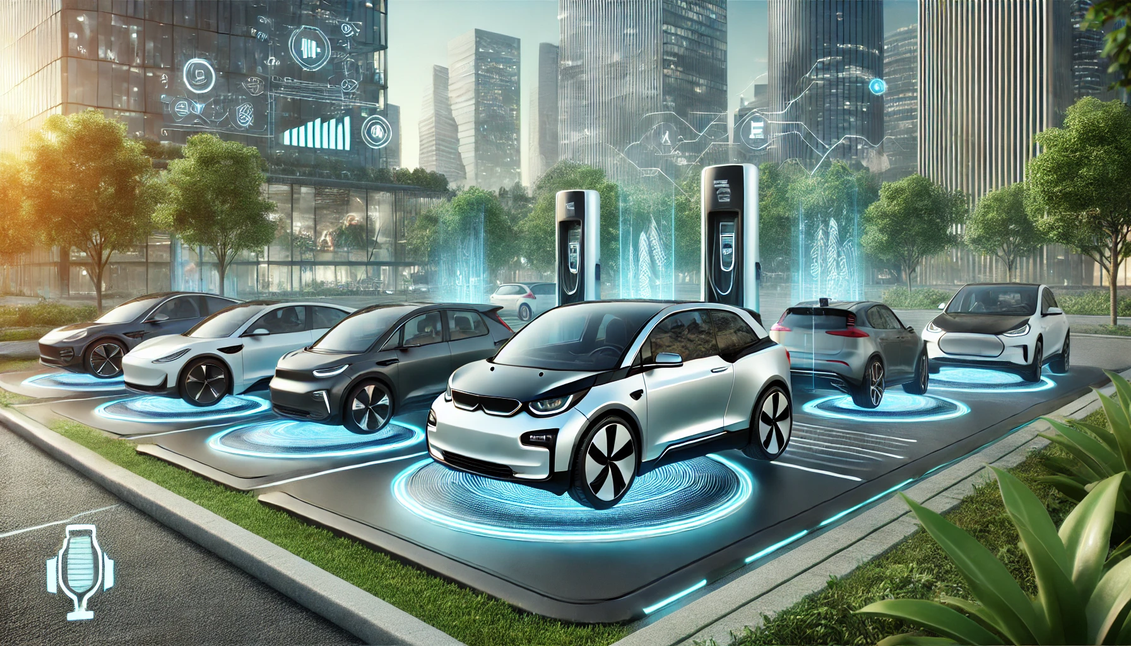
Circuit Diagram

Slide 13
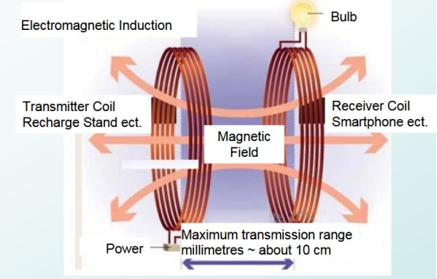
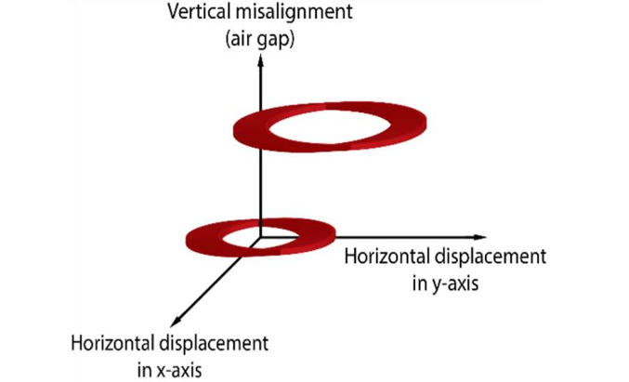
Coil Design and Misalignment of the Transmitter and Reception coils

Slide 14
Use Cases & Testing
Use Cases
Convenience for EV Owners:
Home charging & Public charging.
Autonomous Vehicles:
Autonomous vehicles could park themselves over charging
pads for refueling.
Fleet Management (Taxis ,Buses ,Delivery Vehicles )
Fleet operators can benefit from wireless charging as it
simplifies the charging process for large numbers of
vehicles(could charge throughout the day in between their
routes while parked.)
Urban Infrastructure Integration
Wireless charging technology can be integrated into smart
city infrastructure. Public parking spaces, curbsides, and
traffic signals could include wireless charging pads,
enabling vehicles to recharge while parked or waiting at
signals.
Commercial and Industrial Application
Industrial vehicles, like forklifts, trucks, or construction equipment,could use wireless charging to keep their batteries topped up during idle periods or while on break, enhancing productivity and reducing downtime.
Test Cases
Efficiency and Energy Loss Evaluation
Wireless charging typically has more energy losses than wired charging, making efficiency testing essential. Key factors include energy transfer rates, distance, and power losses.
Alignment Sensitivity
Tests assess how alignment accuracy with the charging pad affects charging performance and how well the system handles misalignment in real-world conditions.
Charging Speed and Power output
Tests are performed to evaluate how quickly the system can charge different types of EV batteries under real-world conditions
Durability and Reliability
Durability tests assess long-term reliability of charging pads, ensuring they withstand weather, dirt, and heavy usage in outdoor public installations.
Health and Safety
Tests ensure that electromagnetic fields (EMFs) from wireless charging systems are within safety limits for human exposure and nearby electronic devices.
Interoperability Across EV Models
Tests evaluate the compatibility of wireless charging systems across different EV models, battery sizes, and configurations to ensure interoperability.
Cost Benefit Analysis and Economic Feasibility

Slide 15
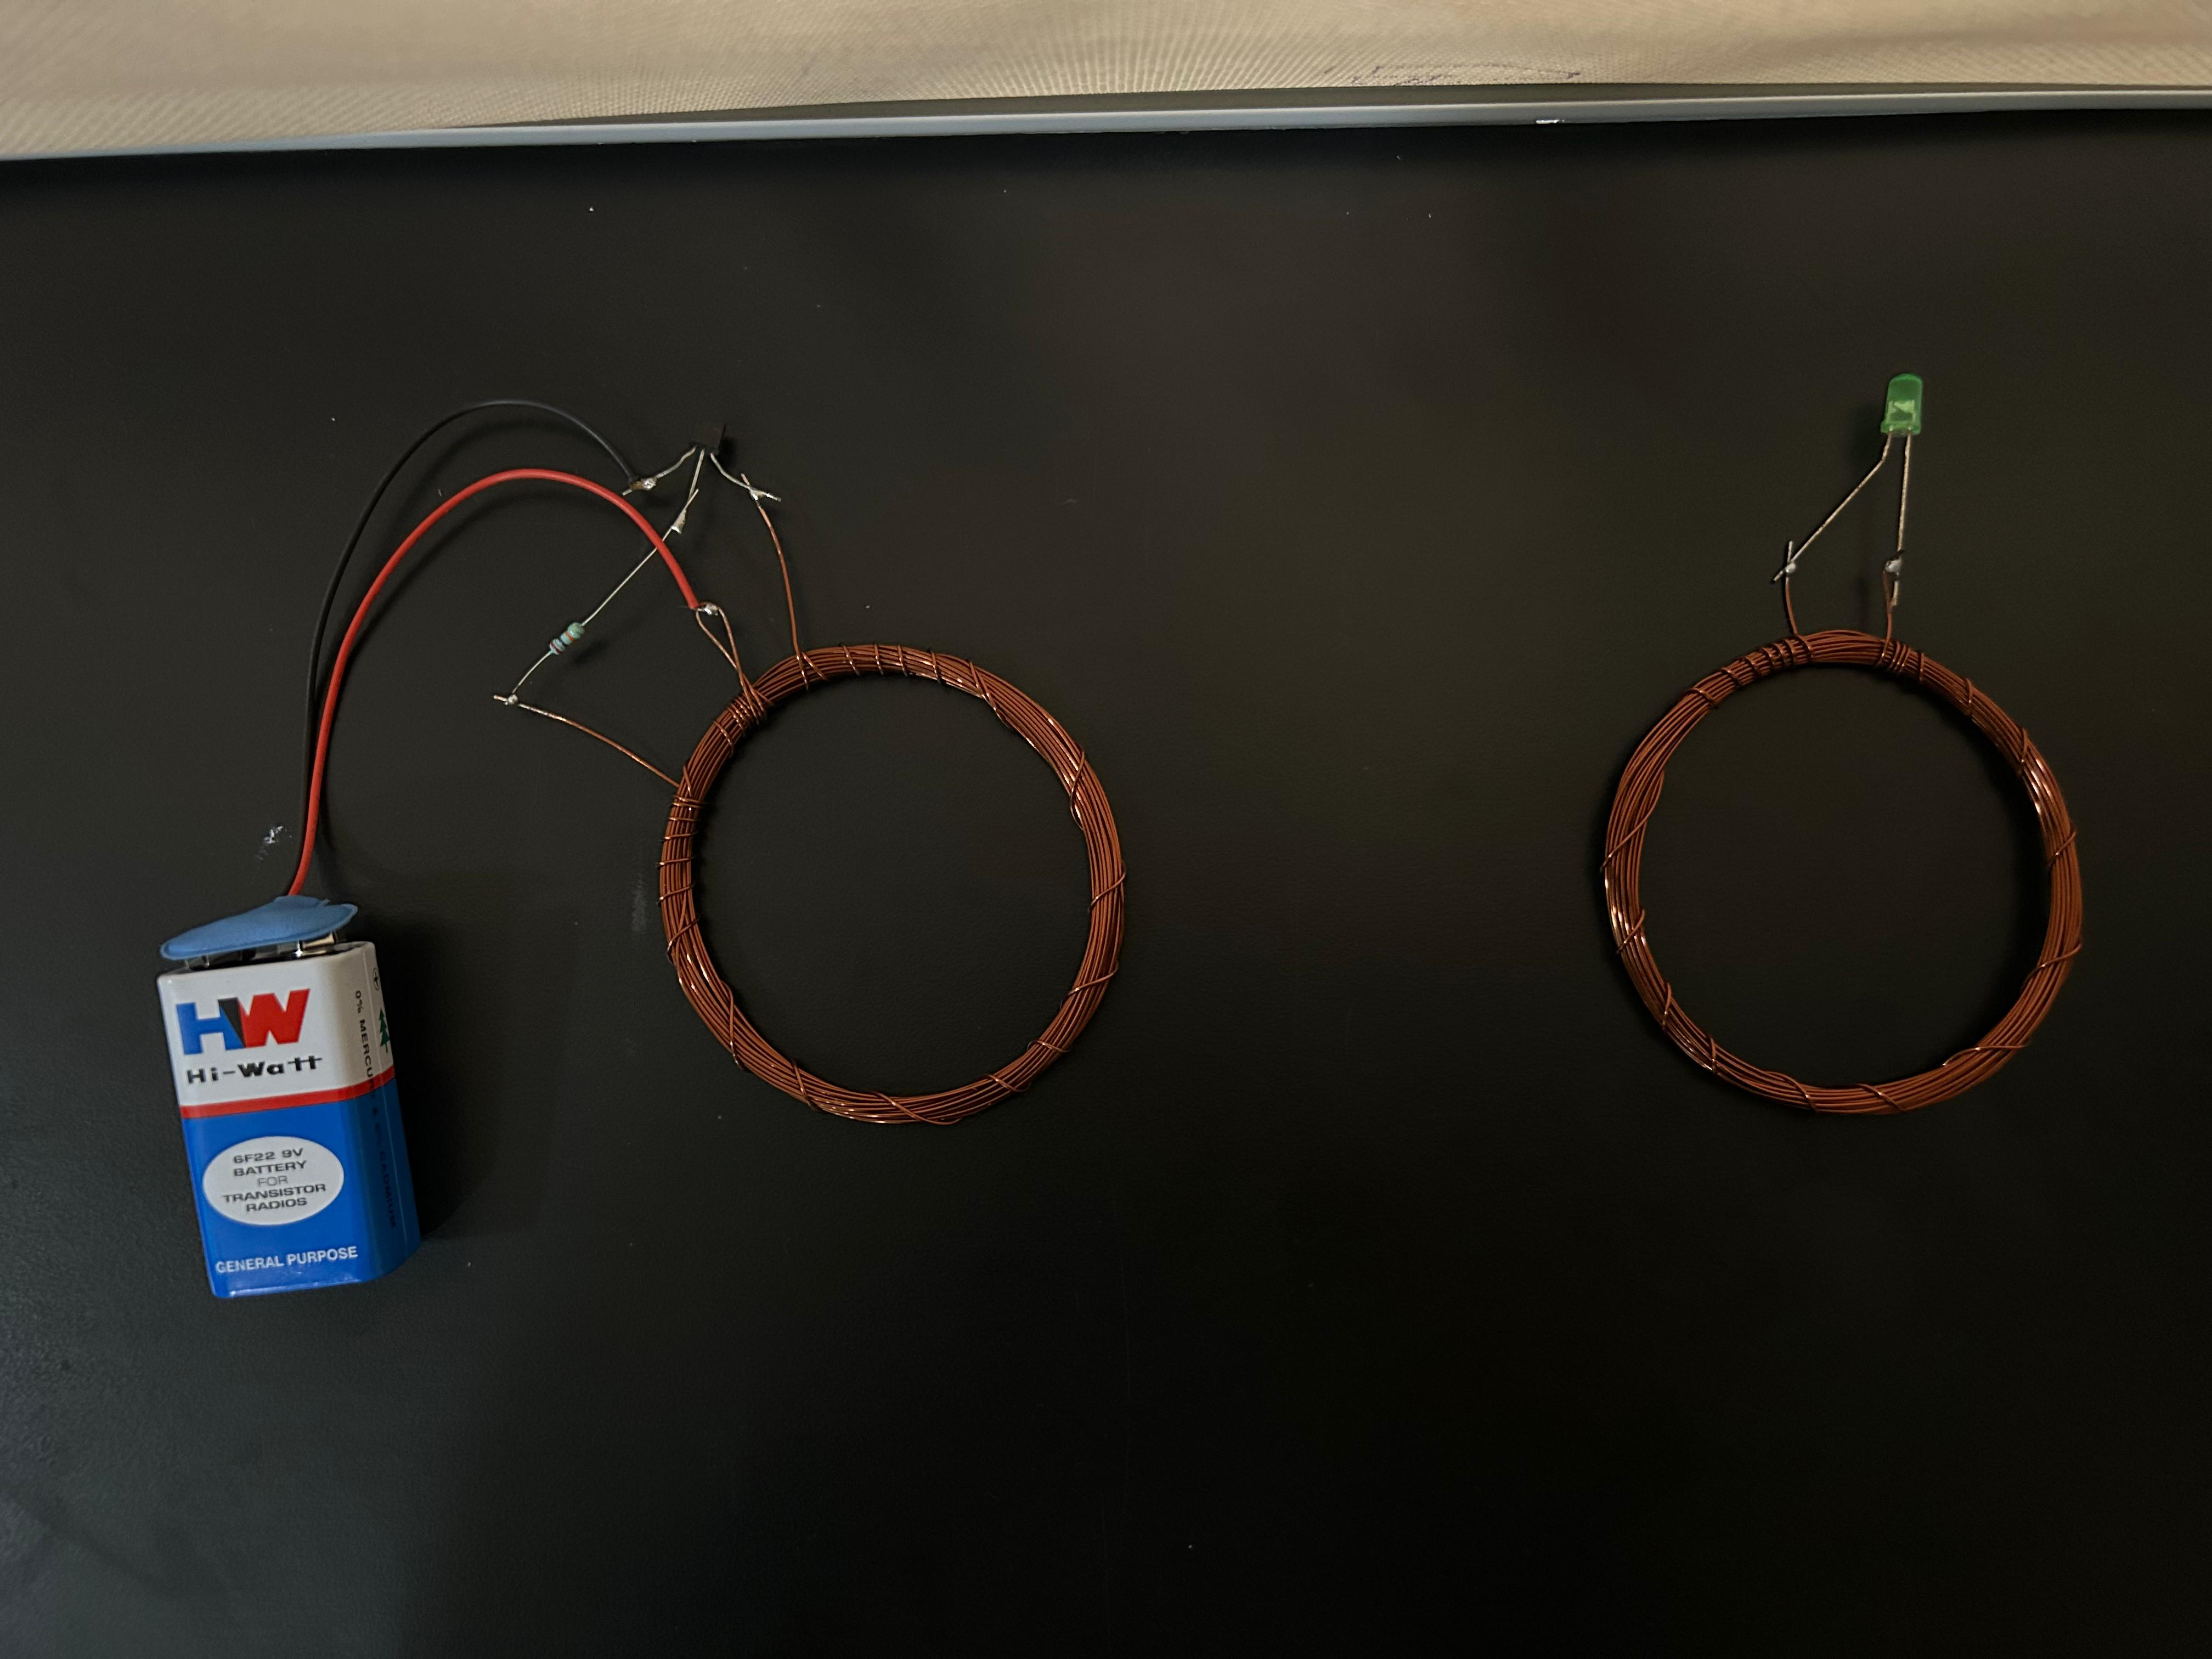
Implementation:

Slide 16
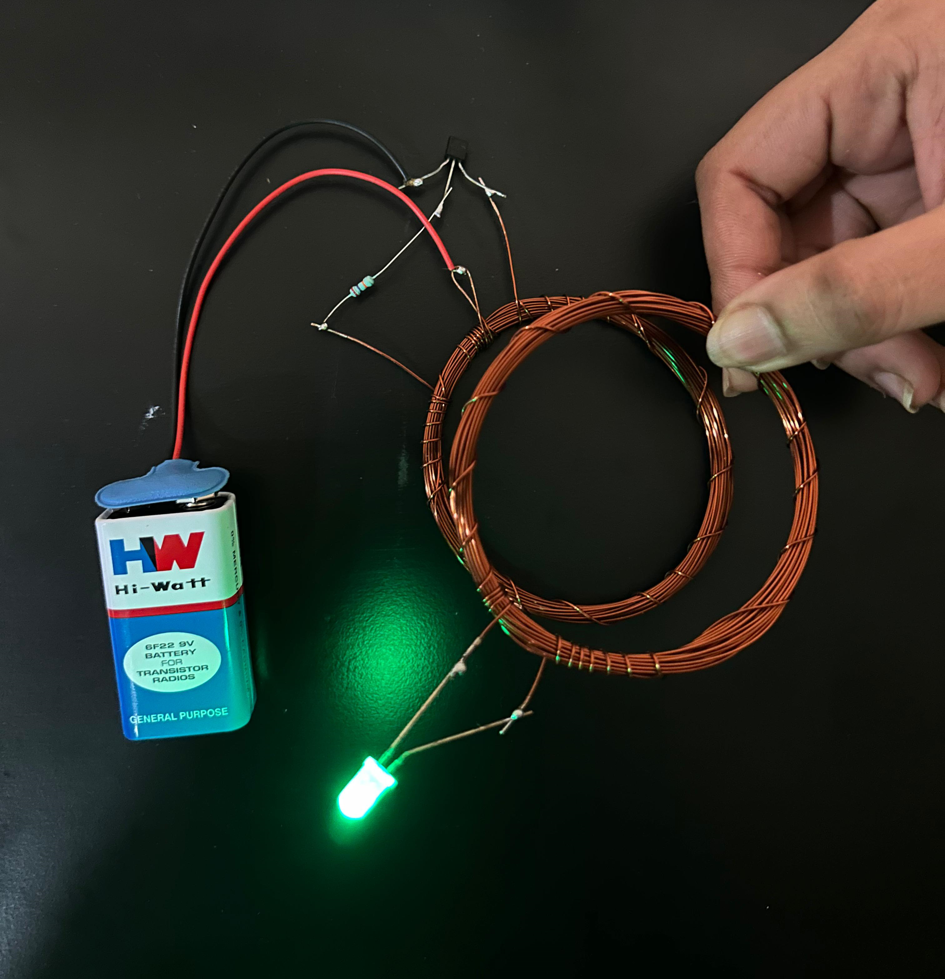
Result:
Video clipping:

Slide 17
IMPACT ON SOCIETY
1.Convenience and Adoption: Wireless charging simplifies the EV charging process, making it easier for users. This could drive higher adoption of EVs, accelerating the shift toward sustainable transportation.
2. Urban Infrastructure: Integration of wireless charging into roads and parking spaces can reduce the need for large, dedicated stations. This can lead to more efficient urban planning and greater use of public space.
3.Economic Impact: Expanding wireless charging will create new business opportunities and jobs in tech and infrastructure. However, it could also displace jobs in traditional fuel industries, requiring workforce adaptation.
4. Environmental Benefits: Increased EV use due to wireless charging can lower greenhouse gas emissions and air pollution. This would contribute to better public health and reduce healthcare costs over time.
5. Smart City Integration: Wireless charging can be incorporated into smart city systems, improving energy management and reducing traffic congestion. This would contribute to the development of more efficient, sustainable urban environments.
6. Accessibility: Wireless charging removes physical barriers, benefiting people with disabilities. This promotes a more inclusive society by increasing mobility and independence.
7. Energy Demand: As wireless charging becomes more widespread, electricity demand could increase, straining power grids. This will encourage investments in renewable energy and grid improvements.

Slide 18

THANK YOU

